Slide 1
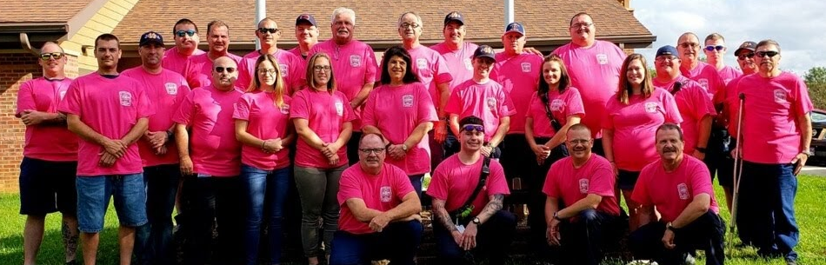
JCESA
FY20 Budget Request

Slide 2
FY19 Budget Recap
Funding Source | Amount
General Fund | $2,037k
Ambulance Fee | $790k
Total | $2,827k*
Expense Category | Amount
Labor | $2,541k (90%)
Non-Labor (Supplies, Utilities, Maint./Repairs, EMS Supplies, Professional Services, Training, Insurance, etc.) | $286k
*$3,007k is total allocation. $2,827k is the amount remitted to JCESA

Slide 3
FY20 Budget Requests
6 additional full-time positions
Additional training
Mental Health Fund
Life insurance value increase & 457(b) match
Additional PPE
2 replacement vehicles
Notes:
457(b) is an Employer-sponsored savings account

Slide 4
6 Additional Full-Time Positions
$366k (after savings from PT hrs recovered)
Current | EMT Hrs/Wk | Proposed | Net +
Sta 1 | 40 FT, 16 PT | 84 FT, 0 PT | 28
Sta 4 | 40 FT, 30 PT | 168 FT, 0 PT | 98
Sta 6 | 40 FT, 16 PT | 84 FT, 0 PT | 28
Sta 7 | 40 FT, 16 PT | 84 FT, 0 PT | 28
Total: | 160 FT, 78 PT | 420 FT, 0 PT | 182
Adds 182hrs of coverage per week
  More peak-time coverage
Converts 78hrs from PT to FT
  Consistency
  Manageability
  Less likely to incur OT
A small step toward peak time staffing
Cost of 6 FT positions is offset by reduction in PT hours
Note: Co. 1 & Co. 6 have requested 1x24x7 staffing, which would require 4 FTEs in addition to what is proposed here.
Notes:
Current Staffing:
Sta 1 is staffed with an EMT 8a-4p, 7 days per week. One FT position works M-F, and S-S are filled with PT.
Sta 4 is staffed with an EMT 8a-6p, 7 days per week. One FT position works 4 alternating days per week, and the remaining 3 are filled with PT.
Sta 6 is staffed with an EMT 8a-4p, 7 days per week. One FT position works M-F, and S-S are filled with PT.
Sta 7 is staffed with an EMT 8p-6a, M-Thu, and 8a-4p S-S. One FT position works M-Thu, and S-S are filled with PT.
The proposal is to convert all of those PT hours into FT positions and extend the hours for each of these stations to 12 hours/day,
Converting the PT hours to full-time:
Improves consistency (same two employees at each station) which helps our volunteer partners, improves familiarity with equipment, and likelihood of those folks becoming drivers.
We currently enter each week with 7 vacant PT shifts to fill, before anyone is sick, on vacation, or has an emergency. This proposal would reduce that to 1 PT shift at the start of the week. Fewer vacant shifts means decreasing the likelihood that OT will be required to fill them (when no PT are available.)
Extending the hours to 12/day:
Adds 98 hours of coverage in areas of the county that have the greatest need for help.
Creates a schedule that allows the conversion to happen (converting current PT hours to FT with the current schedule (8s/10s) does not work)
Moves us slightly toward peak time staffing (2 people per station x 12hrs/day, x 7 days/wk)
Peak time staffing was requested for FY17 and is still desperately needed but we have been advised funding for this will not be approved.
FY19 Staffing Requests:
Company 1 and Company 6 have each requested one EMT 24 hours per day, 7 days per week. To fulfill this request for both companies would require 6 additional FT employees based on our current staffing, or 4 additional positions beyond what we’ve proposed here for FY19.

Slide 5
Additional Training
$23k
Firefighter training for regulatory compliance
EVOC & Live Burn: Risk reduction
12 Lead & Capnography Course: Improve EMS outcomes
Replace non-compliant CPR Manikins
Notes:
With the requested funding, we can
Conduct required fire training to maintain regulatory compliance as a Fire Prevention Unit (such as FFII or Extrication, for those that do not already have it)
Reduce risk by providing a live-burn scenario, and EVOC refresher
the more training we have in a controlled environment, the less likely we are to have catastrophic accidents in operation
Improve EMS outcomes by providing adequate training in 12 lead interpretation and capnography (monitoring of concentration of carbon dioxide in respiratory gasses
Prompt recognition of STEMI and appropriate treatment based on that interpretation are essential in saving lives
Providers well-trained in the use of capnography can make better clinical decisions in complex medical cases
Replace some (not all) of our outdated and defiled manikins with compliant (meets AHA standards) and functional equipment

Slide 6
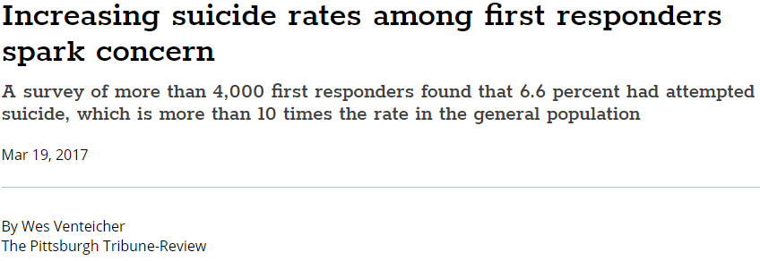
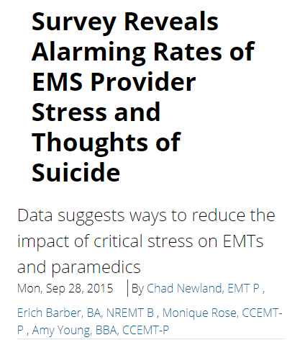
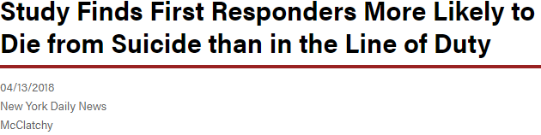
Mental Health Fund
$10k
PTSD in Fire/EMS is significant
Suicide among first responders is high
Our Mental Health deductible is $2,500
Professional help is out of reach for most employees
This fund would work similar to our Healthcare
Reimbursement Arrangement (HRA), but with a group cap
First Responders face high levels of acute and chronic stress as well as high rates of depression and substance abuse, which increase their risk of suicide.

Slide 7
Life Insurance & 457(b)
$6k
Life Insurance: Increase from $50k to $100k for FT employees
Fire/EMS is inherently dangerous
Life Insurance provides some security for families
Employees often cannot afford individual policies
Implement 457(b) matching
Up to $20/pay for FT employees
An effort to offset post-retirement healthcare costs
> Class & Comp. Study recommended improvements to employee benefits. <
$16k
Notes:
We currently provide $50k life insurance for all FT employees. This proposal would increase that to $100k.
The nature of what our people do is inherently dangerous: burning buildings, confined spaces, compromised structures and vehicles, bloodborne pathogens, violence, drugs, etc.
Many times, one person may be alone on a scene waiting for help
Life insurance provides some security for the employee and their family, to help with the costs of a funeral, debts, day care, children’s education, and monthly expenses.
Many of our employees work multiple jobs to make ends meet and all sources of income would cease if they die, leaving their families in a financial disadvantage.
The rates for individual life insurance make it cost-prohibitive for many of our employees. Our rate, purchasing for the group, is significantly less.
We currently offer a 457(b), deferred compensation (retirement savings account) program. We are proposing an employer match of up to $20 per pay period, per FT employee.
Employees are unable to retire due to the cost of health insurance – this would provide one method for them to save for that expense
Our retirement system, EMSRS, is mandatory and allows no additional contributions or flexibility.
The 457(b) match would encourage additional saving and help employees plan for retirement

Slide 8
Additional PPE
$75k
Second set of PPE for full-time employees
  30 sets @ $2,500 ea
NFPA 1851 – Selection, Care, & Maintenance of PPE
FF remains functional while gear is out for cleaning/repair
Cleaning standard is twice per year and whenever soiled
Notes:
Refer to NFPA 1851 Standard on Selection care and maintenance of FF protective equipment
With a 2nd set, the FF would remain functional while primary set is being cleaned, inspected, and/or repaired
There are only 9 on duty during the day, and 5 at night. Taking one OOS because their PPE is out for cleaning, could have a major impact on incident resolution and safety of those operating on scene.
We currently send PPE out annually and whenever it is heavily soiled for cleaning, inspection and/or repair.
The new standard is 2 times per year, plus whenever it is moderately soiled.
The PPE is gone for approximately 1 week.
We only send ¼ of the PPE per quarter, to minimize the number of FF that are OOS for cleaning
With a 2nd set, we could send all at once and reduce the number of trips and logistical complications

Slide 9
2 replacement vehicles
$120k
We currently have 8 vehicles
  Median age is 10yrs
  Median mileage is 95k
Our 5 year replacement plan includes 2 vehicles in FY20
  None were budgeted in FY19
  One new vehicle purchased in FY18, first in 5 years.
  This is a capital Request through the County’s Capital Outlay Fund
Notes:
The agency has not had a capital replacement plan, until now. Our current plan calls for:
2 vehicles in FY20
1 vehicle in FY21, FY22, FY23, and FY24
By FY24 the max age in our fleet will be 10 years old
New vehicles go to field, in the locations of heaviest use
Vehicles being replaced, are moved to locations of lighter use or become staff cars
Our fleet is aging and spending more time in the shop.
One new vehicle was purchased in 2012, one in 2013, and one in 2017.
3 of our vehicles were donations from the Sheriff/County

Slide 10
FY20 Budget Requests
FY19 Total Budget | $2,827k
Annual cost of living at 1.9%* and expected fringe benefit cost increases. | $90k
6 additional full-time positions [considering PT hrs recovered] | $366k
Additional training | $23k
Mental Health Fund | $10k
Life insurance value increase | $6k
457(b) matching | $16k
Backup PPE for all full-time employees | $75k
Total FY20 Annual Operating Budget Request (all of above) | $3,413^{Ŧ}
Total FY20 Jefferson County CIP Request (2 Vehicles) | $120K
* Continuation of Career Ladder / Pay Scale implemented in FY18 based on Class & Comp. Study
^{Ŧ} $3,557k is total allocation. $3,413k is the amount remitted to JCESA

