Slide 1
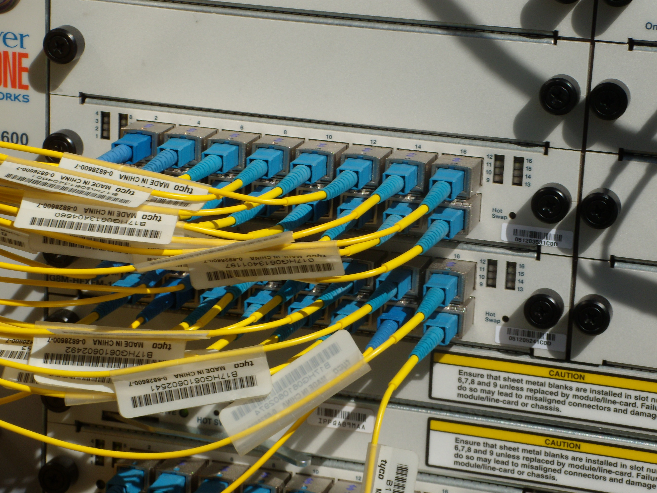
Jefferson County Broadband Study
Andrew Cohill, Ph.D.
Design Nine, Inc.

Slide 2
Survey Results
Residential Survey: 2344 responses— 12% response rate where 3% considered good
Business Survey: 104 responses— very good for size of the county
89% of respondents want better Internet service.
44% of residents are “dissatisfied” or “very dissatisfied” with current Internet service.
86% of business respondents want better Internet access.
99% of businesses indicated that the Internet is essential to their business.
55% indicate that availability of broadband Internet is affecting where they choose to live.
97% of respondents believe that local Government should help facilitate better Internet access
99% indicated that the Internet is important to the success of their business over the next five years.
Only 28% of businesses are “satisfied” or “very satisfied” with their current Internet service.
63% of respondents report they have trouble using common Internet services
33% of the Jefferson County businesses that responded are home-based
88% of businesses that responded need employees to be able to work from home
Copyright © 2010-2020 Design Nine, Inc. All rights reserved

Slide 3
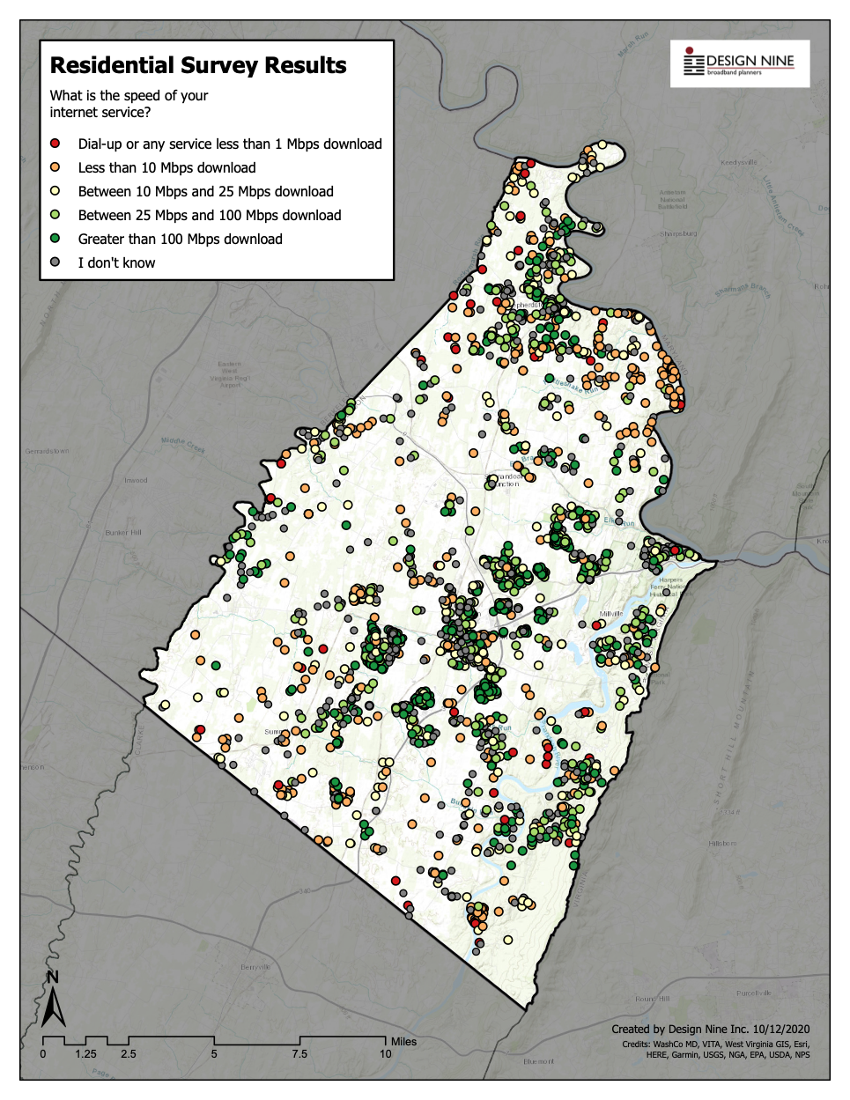
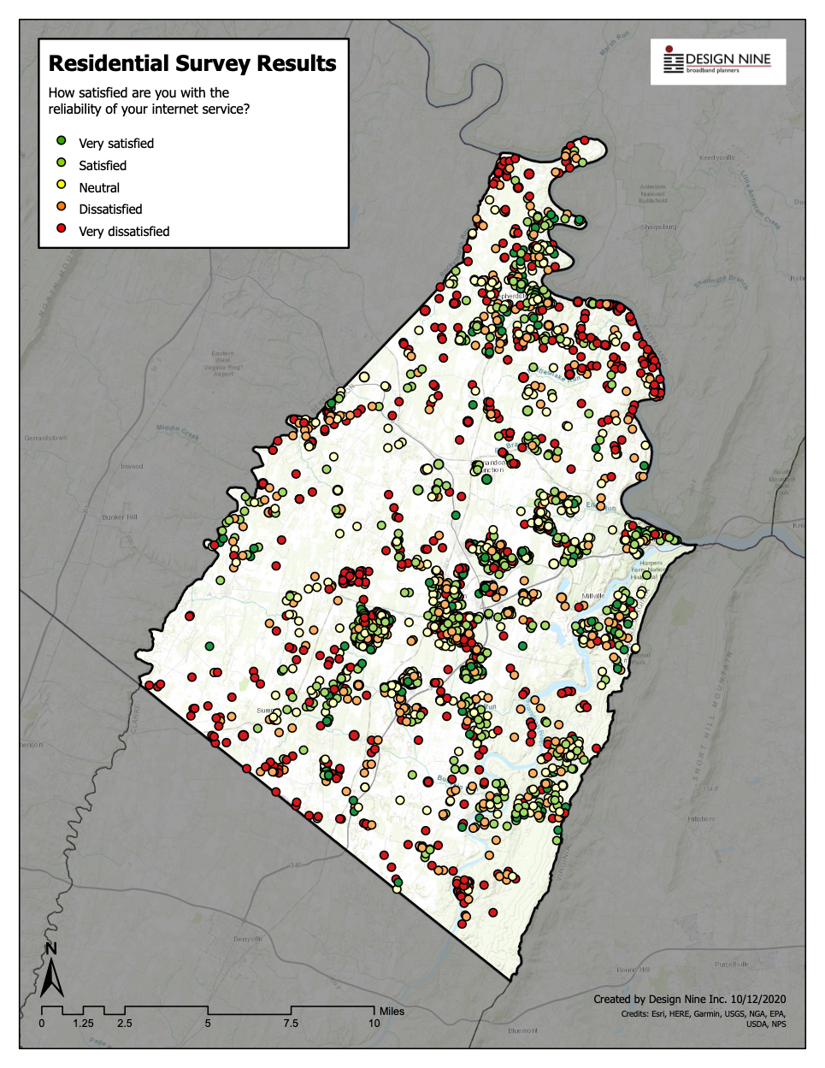

Slide 4
Do the math for Jefferson County
Jefferson County 30 Year Estimated Telecom Expenditures
Total Households | 20,895
Businesses | 872
Estimated Internet Access Type | Households using Cell Phone for Internet | Households with “little” broadband DSL | Households with Cable Modems | Households with no Internet
Household Percentage | 9% | 42% | 32% | 17%
Number of households | 1,881 | 8,776 | 6,686 | 3,552
Average monthly telecom expenditures | Cell Phone for Voice/Internet $90 Cable/satellite TV: $65 bundle | Cell Phone $70 Phone: $13 Satellite TV: $60 Broadband Internet: $45 | Cell Phone $70 Phone $15 TV $43 Broadband Internet $45 | Cell Phone, no Internet, $70 Cable/satellite TV: $65
Monthly Cost of Services | $155 | $188 | $173 | $135
Annual household cost | $1,860 | $2,256 | $2,076 | $1,620
Annual cost all households | $3,497,823 | $19,798,430 | $13,880,966 | $5,754,483
30 year expenditure | $104,934,690 | $593,952,912 | $416,428,992 | $172,634,490
Total residential expenditures | $1,287,951,084
Total Estimated Cost of Hidden Fees | $189,870,859
Total Business Costs | $54,151,200
Total expenditures | $1,531,973,143

Slide 5
Findings
Many residents and businesses lack even minimally adequate broadband
Fixed point wireless broadband important to improving access, creating competition
County should not be in the Internet business, should not compete with the private sector
County role should be limited to providing basic infrastructure for private sector providers
Look for opportunities for public/private partnerships
Grant funds may be available to meet some of the needs
Copyright © 2010-2020 Design Nine, Inc. All rights reserved

Slide 6
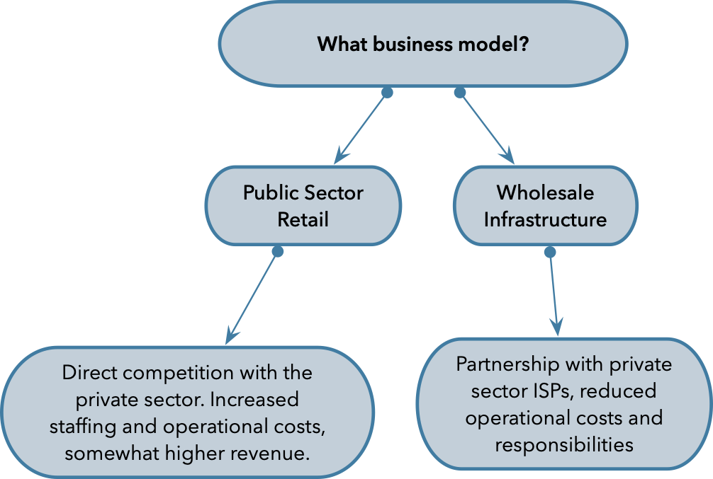
How to Improve Access and Affordability
Make existing tower space improvements to attract more WISPs
Adjust price structure for access to towers
Evaluate need for new towers in areas of high need and no existing towers
Evaluate creating shared backhaul network between towers
Lower WISP capital costs
Create redundant ring for more redundancy and reliability
Could support improved K12 school reliability
Could support public safety voice/data uses
Copyright © 2010-2020 Design Nine, Inc. All rights reserved

Slide 7
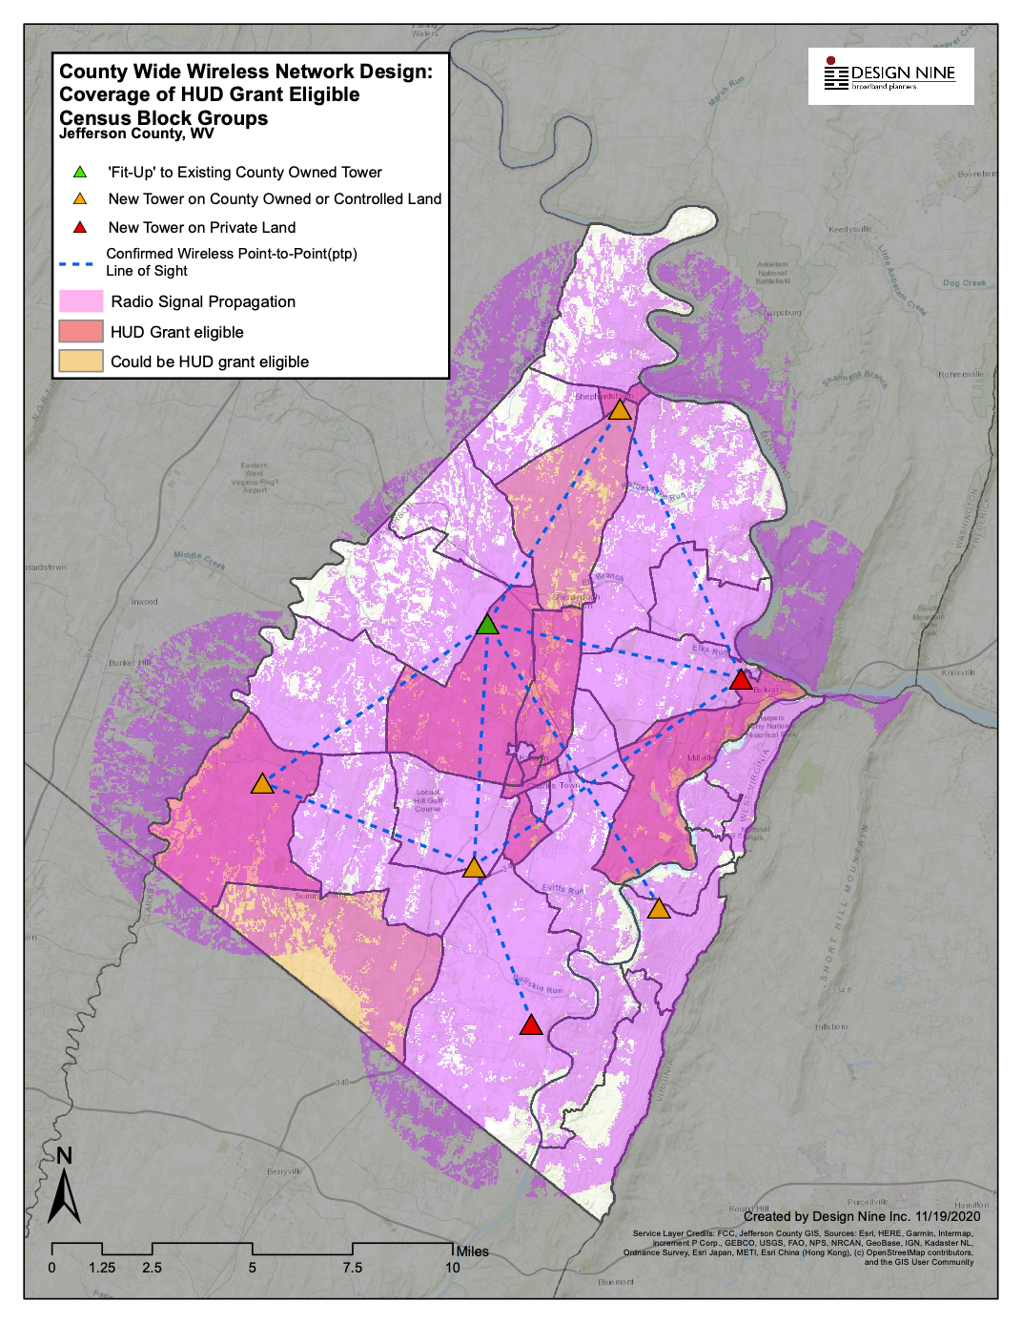
SITE | TOTAL COST
Blue Ridge Mountain VFD Tower | $194,069
Jefferson County Health Department Tower - Bardane | $83,156
Washington High School Tower | $222,138
Middleway Fire Company 6 Tower | $203,425
Shepherdstown Middle School Tower | $203,425
Harpers Ferry Tower | $230,781
Mayerstown Tower | $212,069
 | $1,349,063
Estimated 89% of county covered with fixed point wireless
Some towers are in or could be located in HUD-eligible grant area

Slide 8
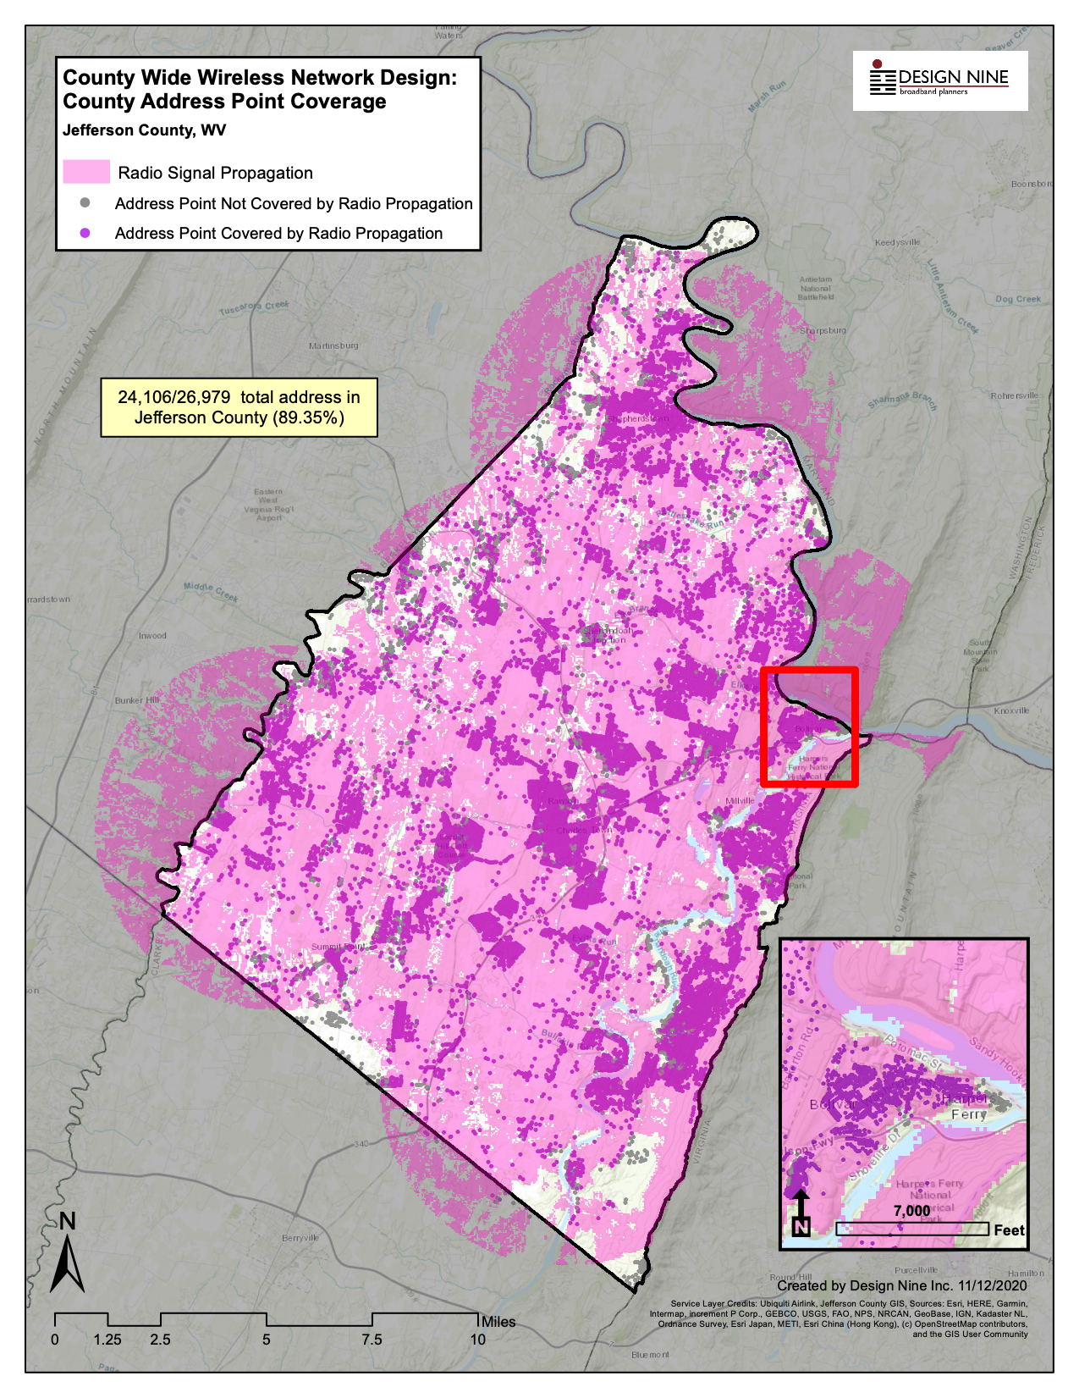

Slide 9
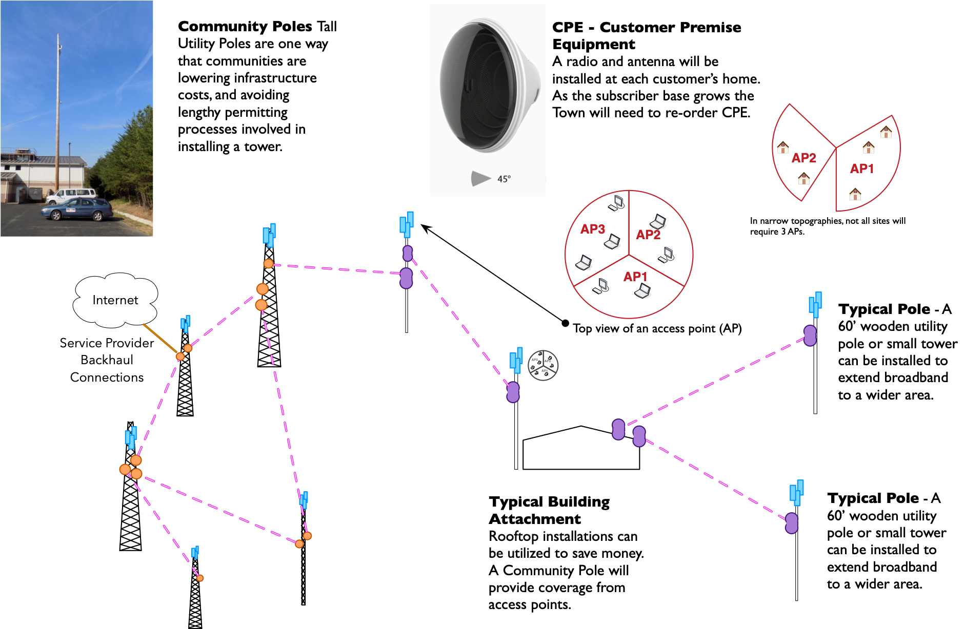

Slide 10
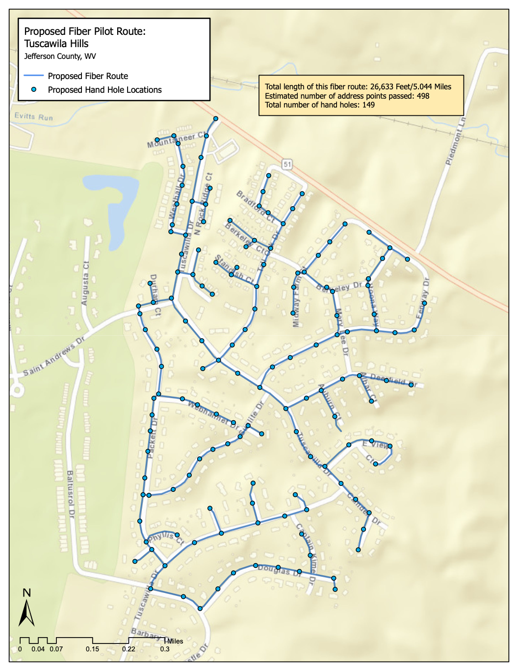

Slide 11
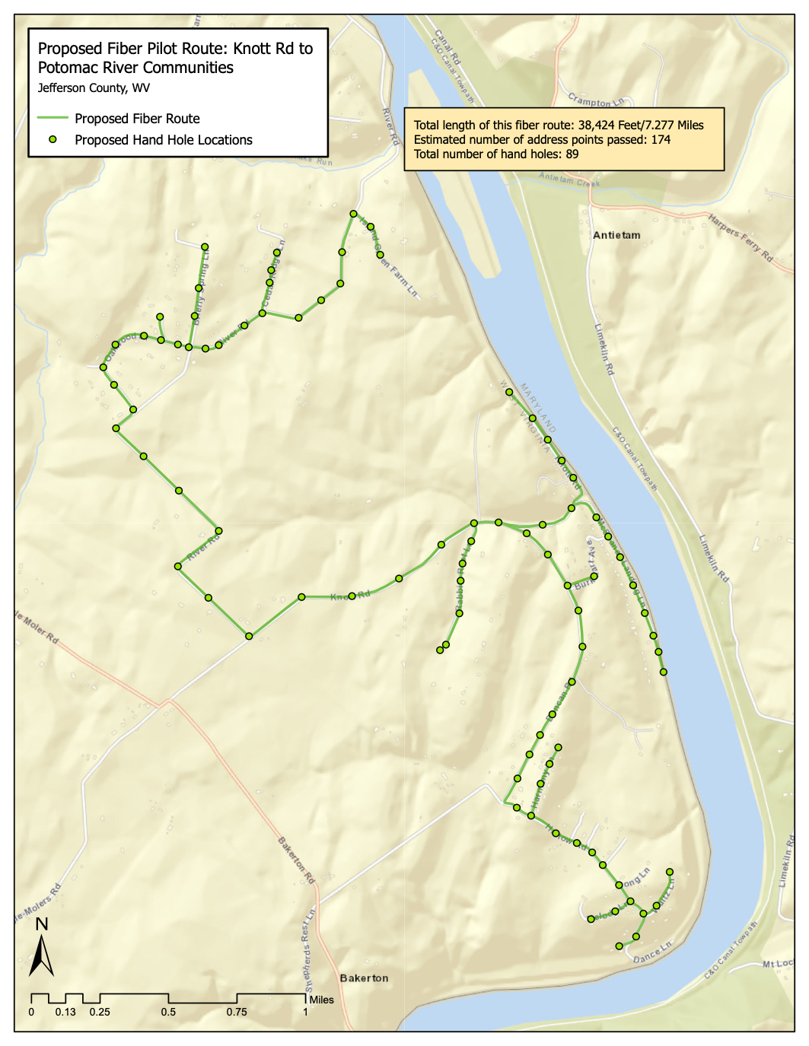

Slide 12
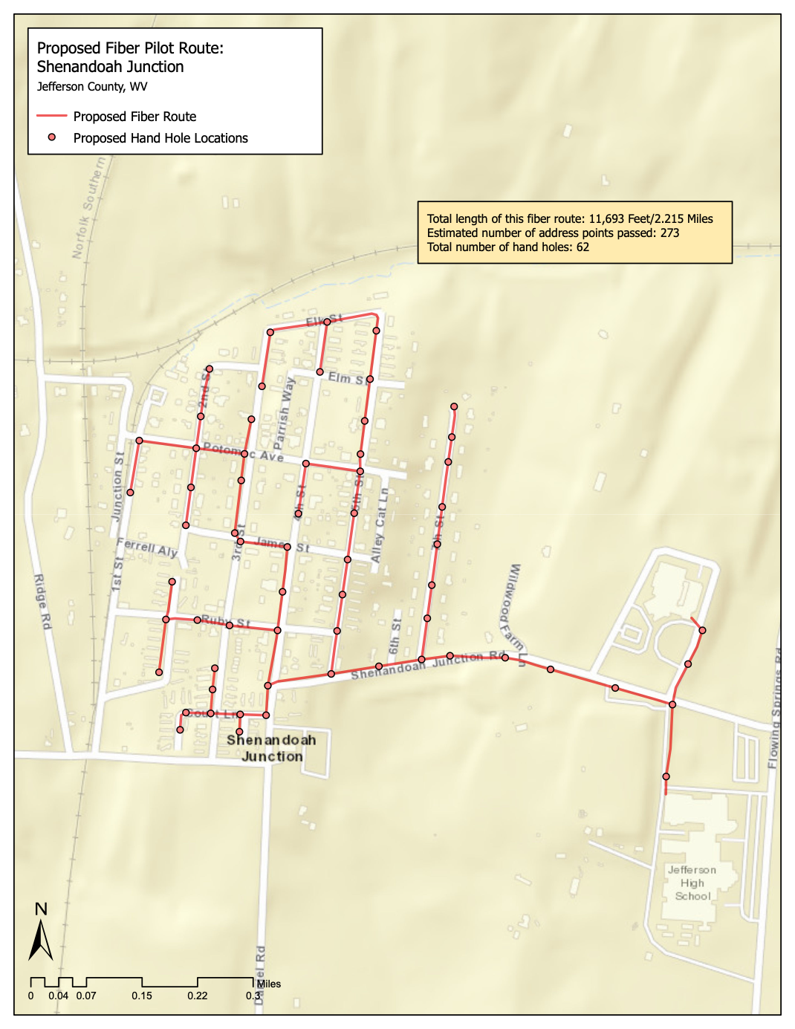

Slide 13
Fiber projects can get Internet from a nearby tower
Fiber with wireless backhaul can easily deliver 100 Meg/100 Meg service
Dark fiber only—service providers install and manage all equipment
Dark fiber very easy for the County to maintain—no day to day responsibility
Fiber repair can be outsourced—additional County staff not required
Knott Road to Potomac River FTTH Pilot Cost Summary
0 | ITEM/PROJECT | ESTIMATED
1 | Knott Road to Potomac River FTTH Pilot Construction Materials | $129,918
2 | Knott Road to Potomac River FTTH Pilot Distribution Labor | $410,733
3 | Knott Road to Potomac River FTTH Pilot Structures, Cabinets, and Equipment | $28,455
4 | Knott Road to Potomac River FTTH Pilot Drop Construction | $88,775
5 | Network Construction Subtotal | $657,881
6 | Project Management, Network Engineering, Integration, and Testing | $78,946
7 | Misc Fees, Advertising, Technical Services | $5,000
8 | Bookkeeping and Administration | $2,500
9 | Engineering, Permitting | $43,680
10 | Legal Costs | $2,500
11 | Network Management Software and Services | $4,500
12 | Other Costs Subtotal | $137,126
13 | Project Total | $795,007
14 | Contingency at 5% | $39,750
15 | Project Total (with contingency) | $834,757

Slide 14
Attracting WISPs
Work with wireless and wireline ISPs
Modest application fee for tower access, use fixed monthly lease fee
Use a single tower space agreement for all providers
Offer a grace period of three to six months to allow WISPs to build subscriber base
Include performance requirements to encourage good service from WISPs
Keep structural analysis costs as low as possible
Some localities charge high engineering analysis fees
Provide space at base of towers for WISP equipment
Keep electric service fees as low as possible
Shared generator access is desirable
Consider single lease agreement that includes all towers
Provides more incentive to offer service throughout Grant County
Copyright © 2010-2020 Design Nine, Inc. All rights reserved

Slide 15
Getting Started
County should not be in the Internet business, should not compete with the private sector
Focus on improved wireless broadband access in the short term
Long term goal should be some fiber to the home in some areas
Critical to attracting and retaining businesses, a younger workforce
Fund for success
Grants could supply much of the funding needed
Manage expectations
Get started with what is possible now
Don’t wait
Develop public/private partnerships with service providers
Look for opportunities to leverage public safety opportunities
Copyright © 2010-2020 Design Nine, Inc. All rights reserved

