Slide 1
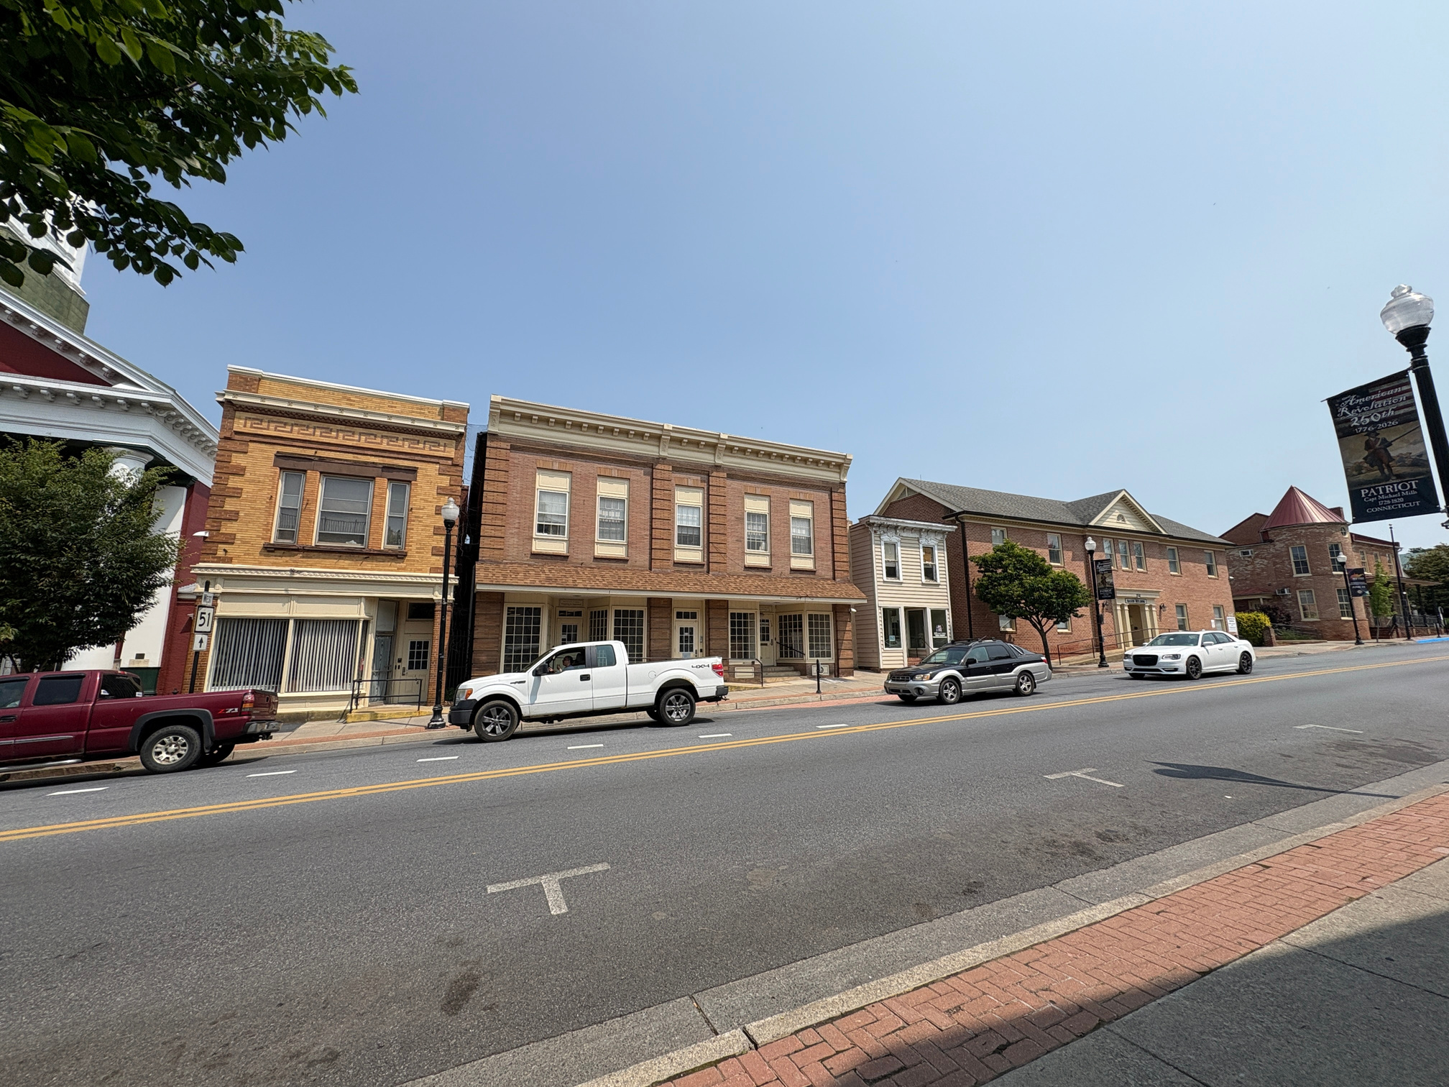

CHARLES TOWN, WV
Washington
Street
Properties
Where Small-Town Charm Meets Big-Time Opportunity.
Laura Kuhn
lkuhn@jeffersoncountywv.org

Slide 2
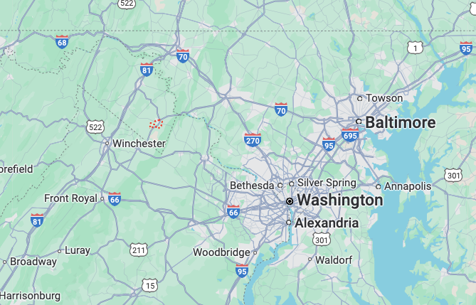


Locations
The Washington Street properites are located on the 100 block of East Washington Street in Charles Town
Hunter House
124 E. Washington Street
Mason Building
116 E. Washington Street
Smoot Building
114 E. Washington Street
Moffett/Reininger Buildings
104-112 E. Washington Street
Jefferson County Courthouse
100 E. Washington Street
Getting Here
1 hour 20 minutes to DC

Slide 3
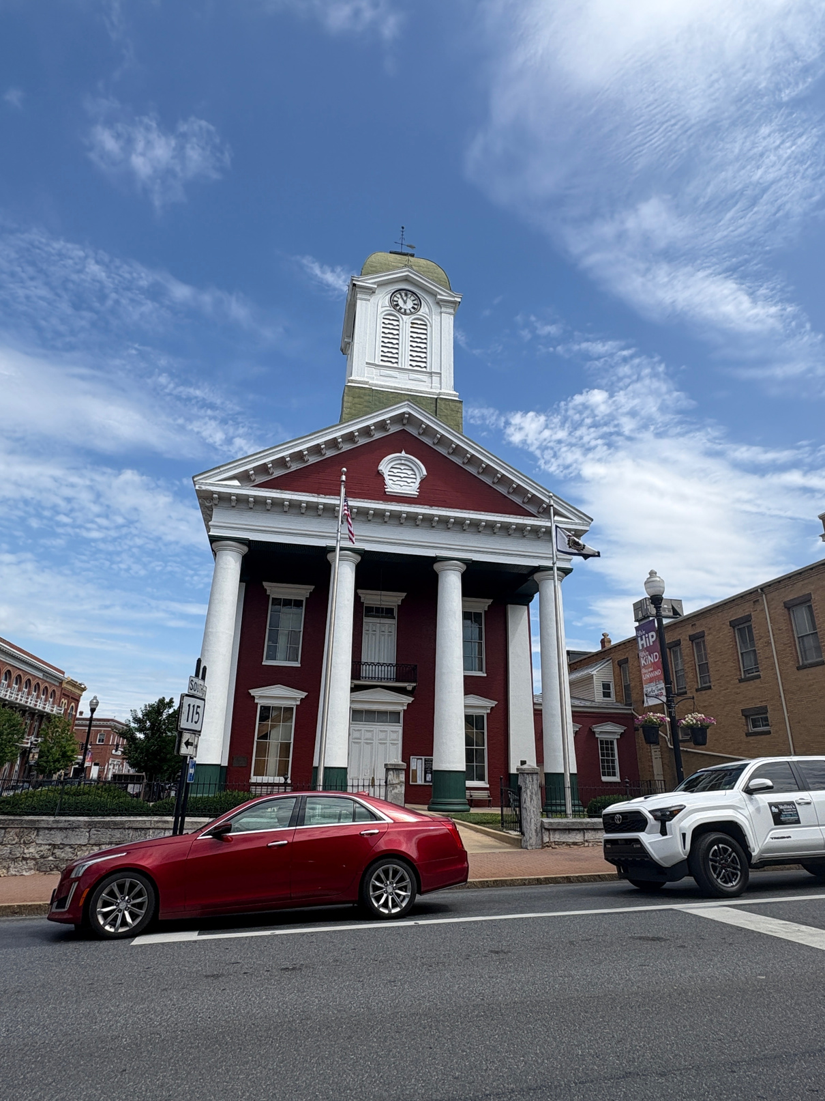
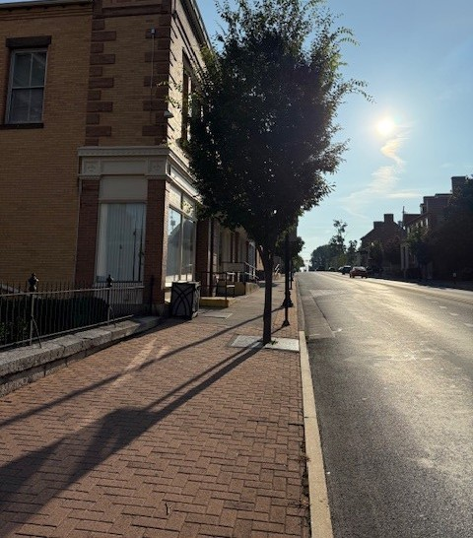
The Neighborhood
Neighborhood Profile
Families and working individuals who are friendly and inviting
Average Age
38.5 years
Median Household Income
$94,830
Nearby Ammenities
Harpers Ferry National Historic Park
Hollywood Casino at Charles Town Races
Summit Point Motorsports Park
Shepherdstown
Appalachian Trail

Slide 4
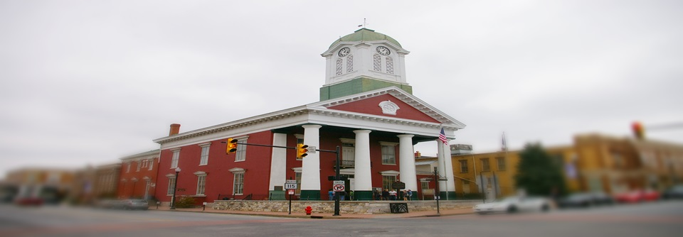
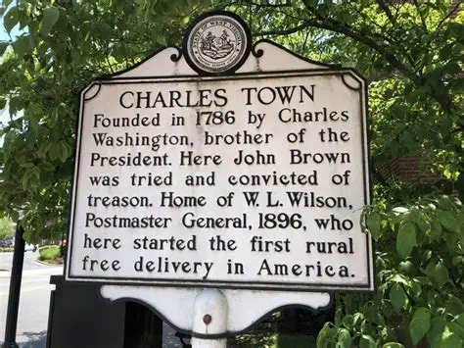
Our History
Founded in 1786 by George Washington’s youngest brother, Charles Town was built for commerce, law, and community—and it still delivers. With a walkable downtown, rich architectural legacy, and strategic proximity to D.C. and the I-81 corridor, the city blends historic charm with modern market potential. From the trial of John Brown to the boom of tourism and revitalization, Charles Town has always been at the center of regional momentum. Today, its historic properties offer rare opportunities for investors to anchor themselves in a growing, high-visibility market.

Slide 5
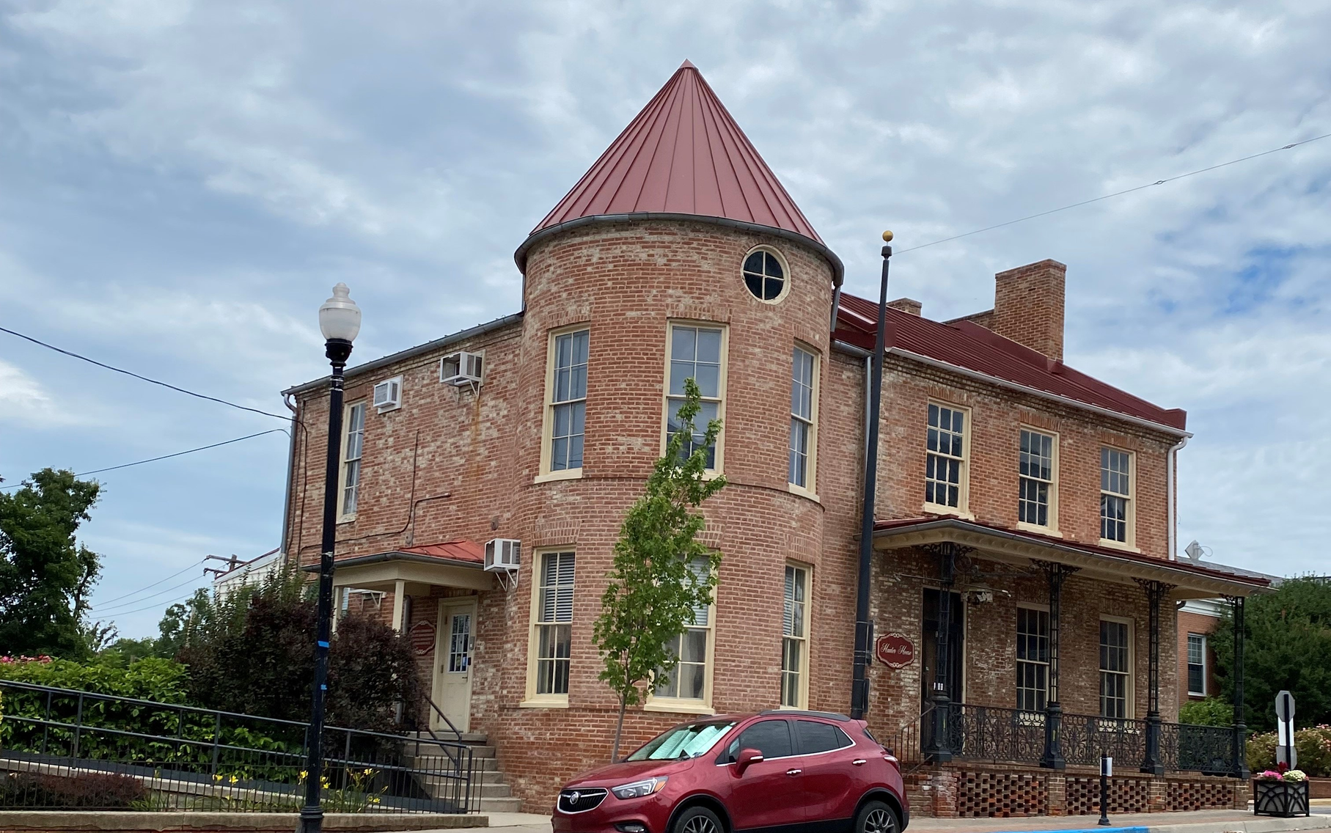
Hunter House
124 E. Washington Street
This stately two-story brick residence, complete with a turret and inviting covered porch, stands as a landmark of Charles Town’s rich heritage
Originally built circa 1820 for Andrew Hunter, a prominent local attorney and chief prosecutor in the John Brown trial, the property symbolizes both civic prominence and architectural grace.
Burned by Union troops in July 1864—ironically under orders from Hunter’s own cousin—it was meticulously rebuilt on its original foundation after the Civil War.
In the mid‑20th century, the building gained life as the beloved Iron Rail Restaurant, adding a commercial legacy to its historic significance.

Slide 6
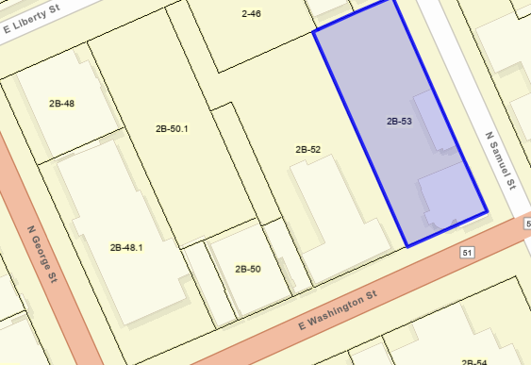
The
Details
Hunter House
5,825 GSF
Lot Size - .344 acre
The Hunter House property features a spacious grassy rear yard that enhances the site’s historic residential character and provides green space within the downtown setting. At the back of the lot stands a small carriage-style house at 1,881 gsf.
Currently houses the County Commission Administrative Offices and the Prosecuting Attorney (Civil Division)

Slide 7
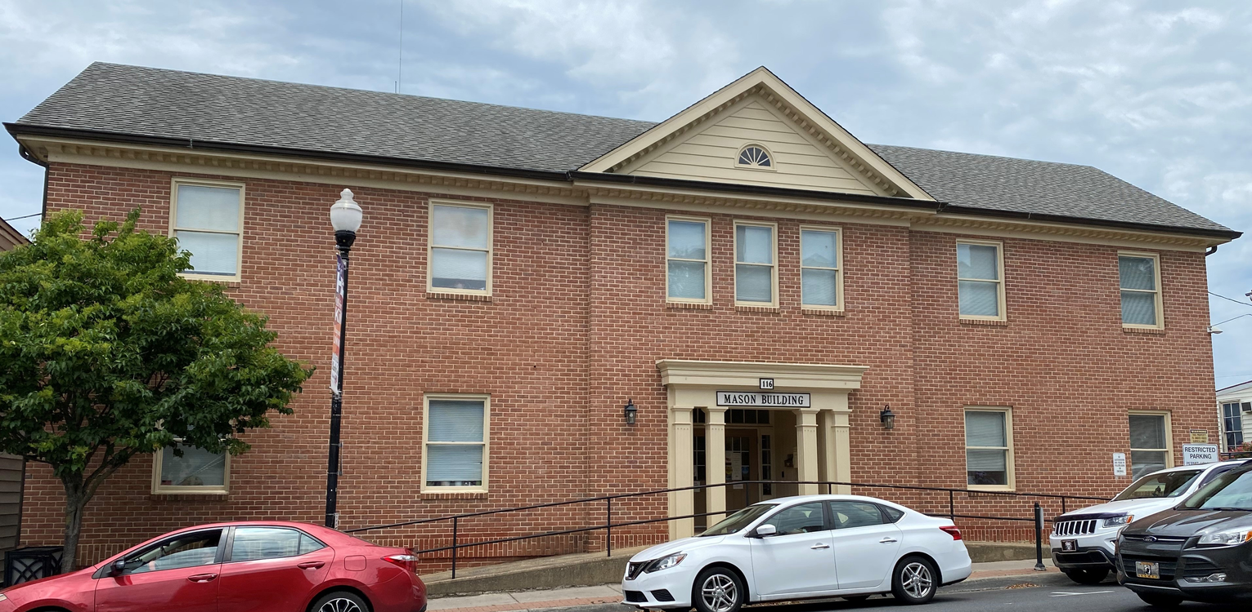

Mason Building
116 E. Washington Street
The Mason Building is a two-story red brick office structure with a symmetrical and traditional design. The building features a central entrance highlighted by a modest pediment and columned portico, adding a touch of classical architectural style. A gable with a decorative half-moon vent crowns the central section of the roofline. Windows are evenly spaced across both floors, with double-hung sash windows framed by subtle brick lintels and sills. The front entrance is accessible by a ramp, enhancing accessibility while maintaining a clean and professional façade.

Slide 8
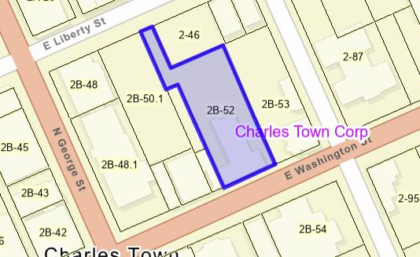
The
Details
Mason Building
13,272 GSF
Lot Size - .449 acre
After its purchase by the county, the building initially served as the home of the Sheriff’s Department. Parks and Recreation also operated from this location until relocating to Sam Michaels Park. Additionally, the Jefferson County Department of Homeland Security and Emergency Management was based here before moving to Bardane.
Currently houses the Department of Engineering, Planning & Zoning, GIS, IT, and the county’s mailroom.

Slide 9
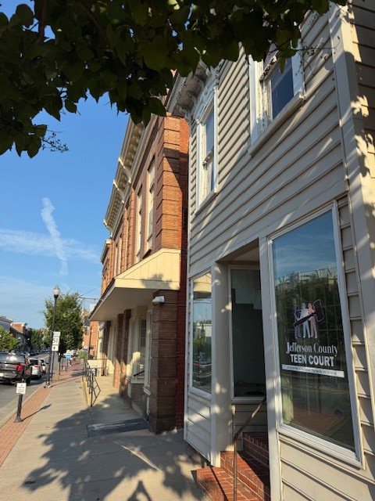
Smoot Building
114 E. Washington Street
The Smoot Building is a narrow, two-story structure with a modest but distinct historic appearance. Its upper façade features detailed cornice brackets and ornamental window hoods. The second-story windows are framed in white trim and adorned with decorative woodwork. The storefront entrance includes a recessed doorway flanked by two large display windows. Though compact in size, the building’s decorative trim and prominent front-facing windows give it a recognizable and somewhat vintage storefront character along the streetscape.

Slide 10
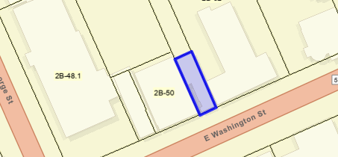
The
Details
Smoot Building
1,487 GSF
Lot Size -.03 acre
Before being purchased by the county, the Smoot Building was an insurance agency. The building is currently vacant due to egress issues identified by the West Virginia State Fire Marshal. In the past, it housed the Jefferson County Impact Fee Office, which was later absorbed into the Department of Engineering, Planning, and Zoning. The building also temporarily served as a location for the Tax Office and Jefferson County Teen Court.

Slide 11
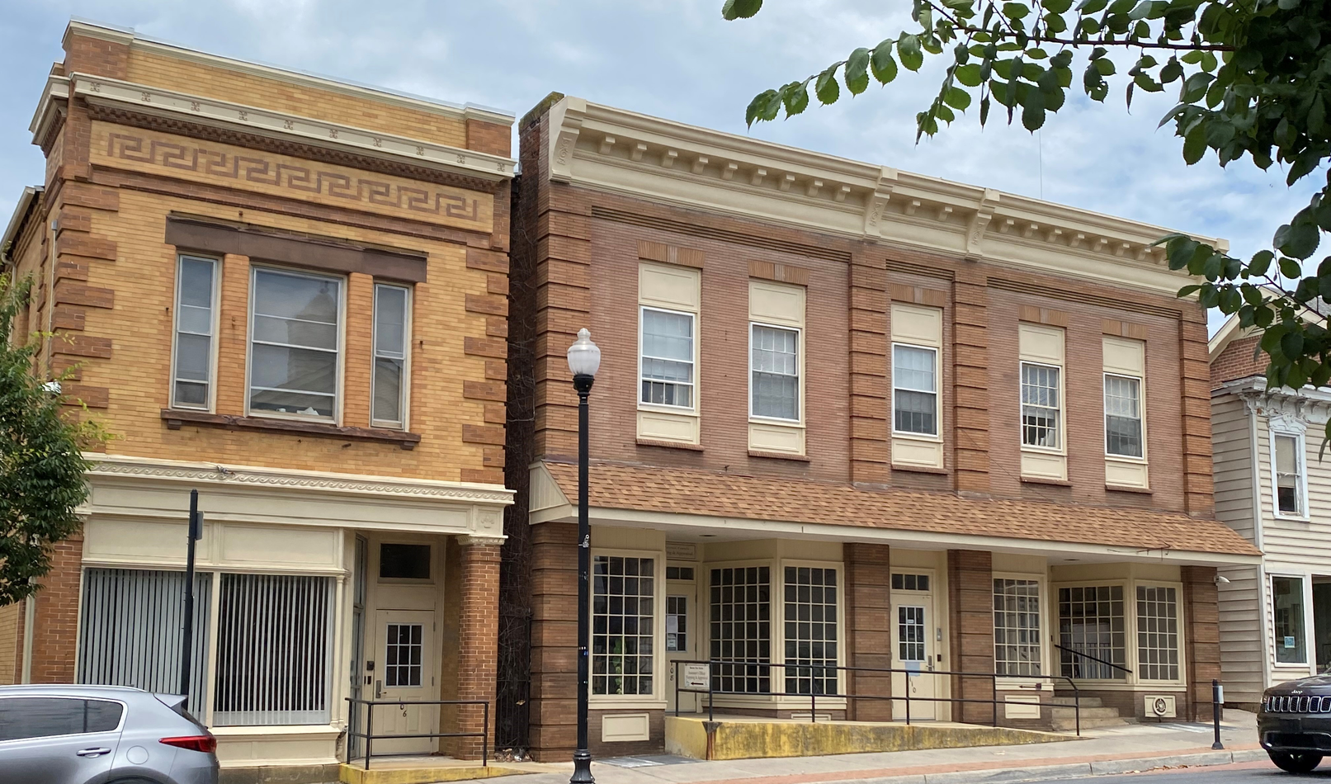
Moffet/Reininger Buildings
104-112 E. Washington Street
The Moffett and Reininger Buildings are two connected, two-story brick structures. The Moffett Building, on the left, features a buff brick façade with decorative brown brick accents and a classical Greek key frieze beneath an ornate cornice. A large, storefront-style window and a recessed doorway reflect its early 20th-century commercial origins. The adjoining Reininger Building to the right showcases a more uniform red brick exterior with detailed brickwork around the tall, narrow windows and a prominent cornice with dentil molding. The ground floor includes multiple entrances with large display windows and a covered entrance porch, now equipped with accessibility ramps.

Slide 12
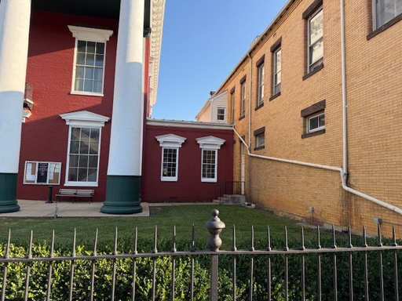
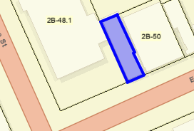
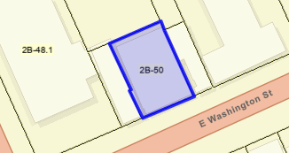
The
Details
Moffett/Reininger Buildings
Moffett: 5,172 GSF, Lot Size - .034 acre
Reininger: 7,755 GSF, Lot Size - .087 acre
The Moffett and Reininger Buildings have undergone several functional transformations over the years. Originally, the first floor of the Moffett side housed the Assessor’s Office, while the Reininger side included the County Meeting Room and the Tax Office. The second floors accommodated Engineering, Planning & Zoning (Moffett) and the County Commission offices (Reininger). As needs shifted, the Assessor’s Office expanded into the former meeting room space after meetings were relocated to the library basement. When the Tax Office later vacated its space, the Assessor’s Office expanded further into the Reininger side. The County Commission relocated to the Hunter House, and Engineering, Planning & Zoning moved to the Mason Building. The vacated spaces were then repurposed to house Probation services.
The Assessor now occupies the entirety of the first floor of both buildings while the Probation Department occupies the second floor.
Moffett
Reininger

Slide 13
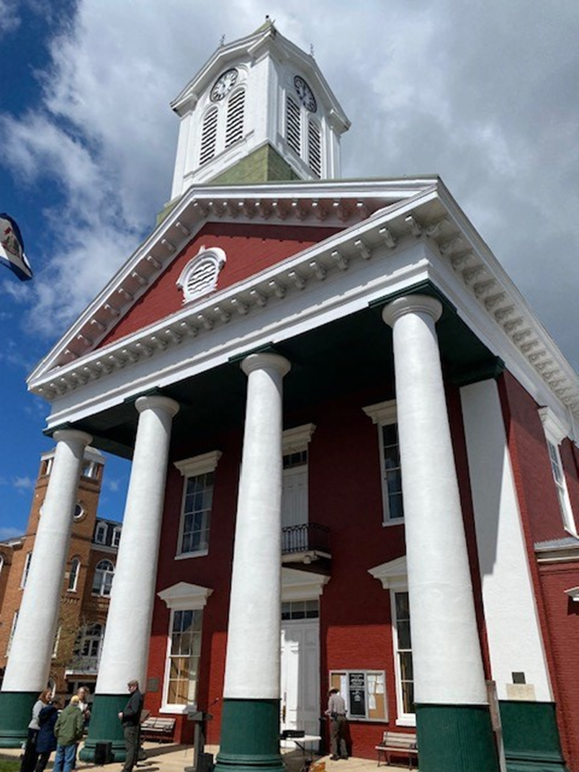
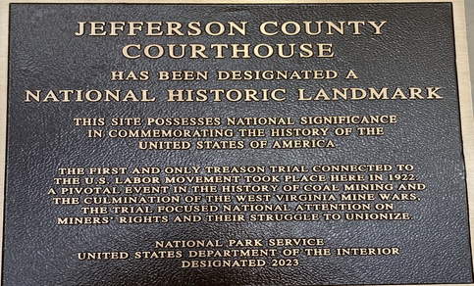
Historic Courthouse
100 E. Washington Street
The Historic Jefferson County Courthouse is a striking example of Greek Revival architecture and a central landmark in downtown Charles Town. Its red brick exterior is accented by a grand portico supported by the towering white columns, leading to a classical pediment with a louvered arch vent.
Rising above the roofline is the stately, clock tower. The tower includes four clock faces that overlook the surrounding streets. The tower not only enhances the building’s historic character but also serves as a visual focal point for the town, visible from blocks away. Listed on the National Register of Historic Places, the courthouse has served a variety of public functions over the years, connecting the community’s past with its present through both its architecture and its ongoing civic role.

Slide 14
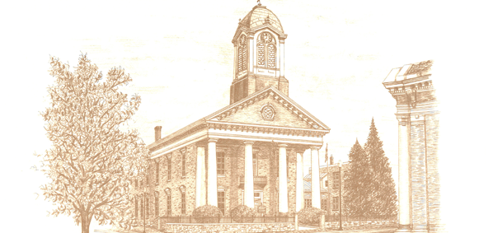
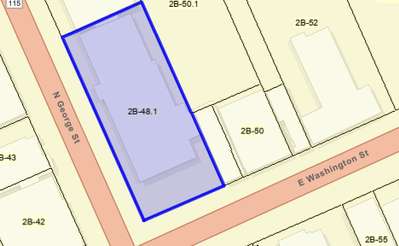
The
Details
Historic Courthouse
17,850 GSF
Lot Size - .354 acre
Over the years, the Historic Jefferson County Courthouse has served as the central hub for numerous county departments, reflecting its longstanding role in local governance. In addition to housing the Circuit Court and County Clerk—functions it still serves today—the courthouse was once home to the Circuit Clerk’s Office, the County Commission offices, and the County Commission meeting chamber. These essential government functions operated under one roof, making the courthouse not only a judicial center but also the administrative heart of Jefferson County. Its multifunctional use over the decades highlights the building’s significance in the daily workings of county government and its enduring role as a symbol of civic leadership.

Slide 15
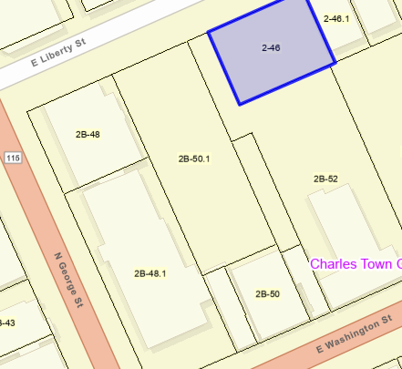
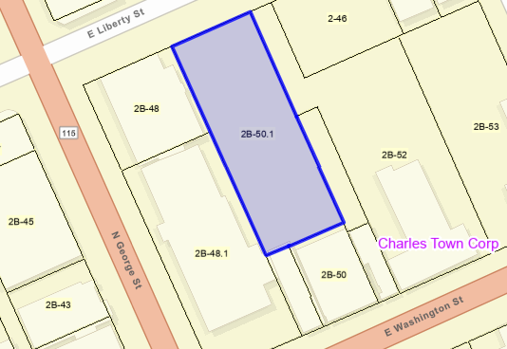
The
Details
Parking Parcels
Parking Parcel - .0157 acre
The Hunter House and Mason Building parcels include dedicated parking areas. Together, these two separate parcels provide convenient parking behind the Courthouse, Moffett, and Reininger Buildings, as well as an auxiliary lot accessible from Liberty Street.
Parking Parcel - .291 acre

Slide 16
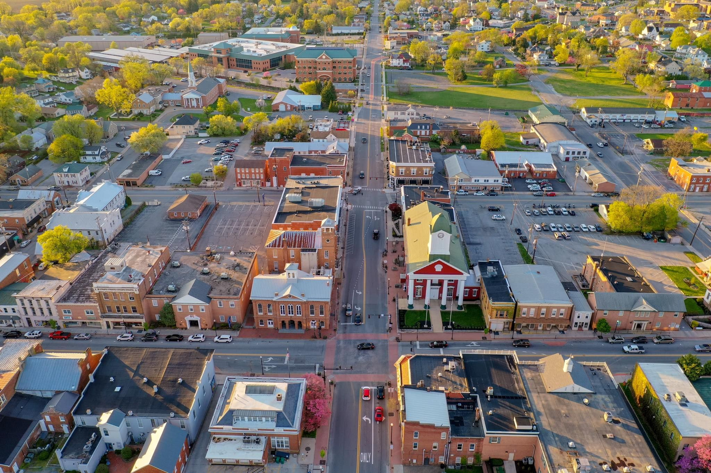
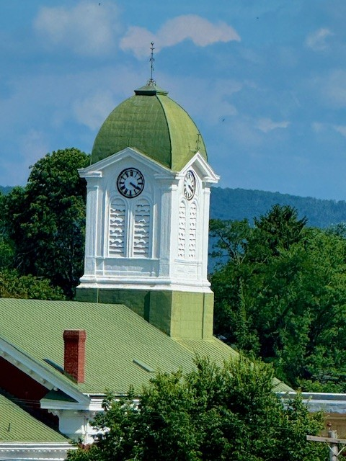
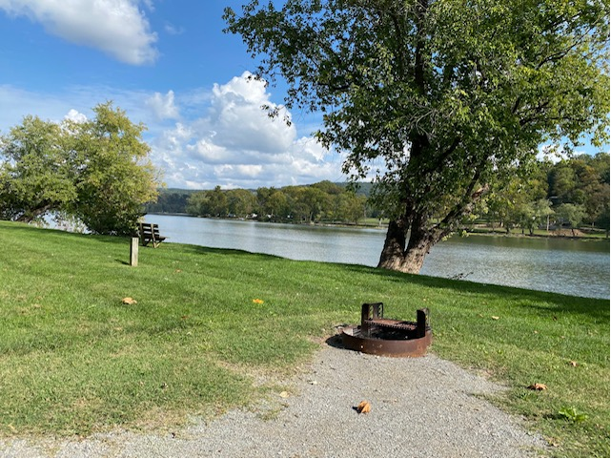
Tourism Market
Jefferson County leads West Virginia in tourism spending, with over $825 million in annual visitor expenditures—more than any other county in the state. Tourism here is growing steadily, driven by visitors from D.C., Northern Virginia, and beyond who come for history, gaming, recreation, and dining. With a strong, diverse tourism base and year-over-year growth, downtown Charles Town offers investors rare access to West Virginia’s most dynamic visitor market.

Slide 17
