Slide 1


City of Charles Town
Jefferson County Development Authority

Slide 2
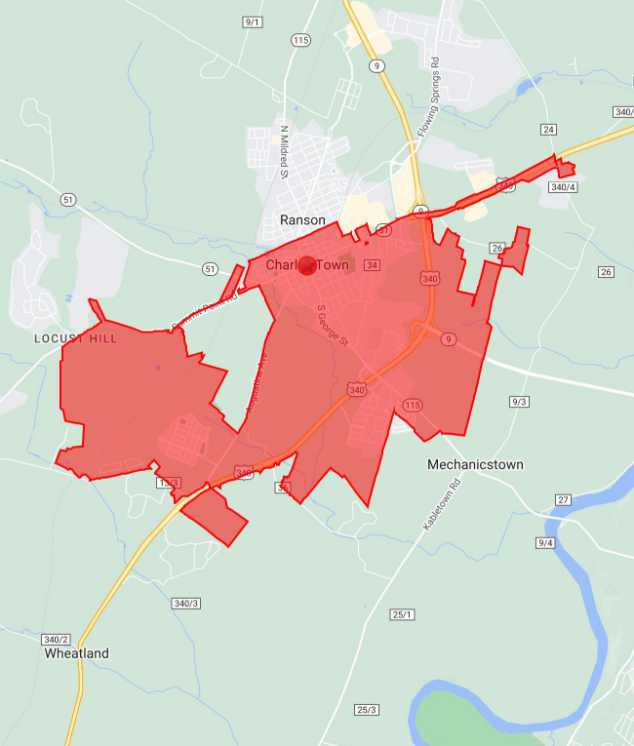





Overview
Population (2023) 6,797
Households (2023) 2,727
Median Age 41.8 years
(0.1 years older than County average)
333 businesses
Median Household Income $97,280
($8,263 less than County average)

Slide 3

Age & Income
Median age of householder 54.3 years
(0.7 years older than County average)
Median household income $97,280
($8,263 less than County average)
 | Total | Under 25 | 25 to 34 | 35 to 44 | 45 to 54 | 55 to 64 | 65 to 74 | 75+
Number of households | 2,727 | 53 | 345 | 482 | 467 | 517 | 477 | 384
Median household income | $97,280 | $69,375 | $93,617 | $112,028 | $120,170 | $105,053 | $72,500 | $59,655

Slide 4

Housing
Total Housing units (2023): 2,920
Owner-occupied units (2023): 70.8% (71.5% County)
Renter-occupied units (2023): 22.6% (20.6% County)
Vacant housing: 6.6% (7.9% County)
Median home value (2023): $289,361 ($5,014 more than County average)
Median rent (2023): $779 ($35 less than County average)
Size of household
1 person 846
2 person 903
3 person 374
4 person 365
5 person 147
6+ person 62

Slide 5



Labor Force
Labor Force (16+): 5,597
Civilian Employed: 64.3% (64.2% County)
Civilian Unemployed: 2.6% (1.8% County)
Not in Labor Force: 33.1% (33.9% County)
Blue collar: 33.6% (38.6% County)
White collar: 66.4% (61.4% County)

Slide 6
Business Detail

Slide 7



Consumer Expenditure
Total Expenditures
$73,650 per household
$29,549 per capita
Non-Retail Expenditures
$39,112 per household
$15,692 per capita
Retail Expenditures
$34,538 per household
$13,857 per capita
$200,843,600
$106,659,704
$94,183,896

Slide 8
Spending
Shelter $15,489
Transportation $13,265
Food and Beverages $10,656
Health Care $6,036
Utilities $5,126

Slide 9



Retail Potential
Motor Vehicle, Parts Dealers - $18.65 M
New Car Dealers - $14.25 M
Tire Dealers - $765.63K
Motorcycle, Boat Dealers - $683.82K
General Merchandise Stores - $13.44 M
Department Stores - $3.56 M
Warehouse Superstores - $8.56 M
Other General Merchandise Stores - $1.32 M
Food, Beverage Stores - $13.36 M
Grocery Stores - $11.9 M
Liquor Stores - $593.45K
Convenience Stores - $458.44K

Slide 10
Retail Gap
Motor Vehicle, Parts Dealers (72)
New Car Dealers (100)
Tire Dealers (100)
Motorcycle, Boat Dealers (100)
General Merchandise Stores (89)
Department Stores (100)
Warehouse Stores (100)
Other General Merchandise Stores (-12)
Food, Beverage Stores (32)
Grocery Stores (44)
Liquor Stores (100)
Convenience Stores (-81)
-Coming to trade area: saturated
+Leaving trade area: opportunity

